Slide 1

Profitability and Sales Dashboard
Using Power BI
By,
Chinmayee Adhyatmabhattar

Slide 2
About the dashboard
Features of the report
25 + Measures
KPI Cards
Embedded icons in card
Consistent formatting
Slicers
Quick Navigation
Info Page
Embedded Data set
Guage Visual
Tables
Conditional Formatting in a table
Bar charts
Field Measures Logo
Clean dataset
LBS: LOW BOX SHIPMENTS < 50 boxes (Sample)
Dynamic
Salesperson Picture in table
Sales, Profits in “K” (thousand)
Data Bars inside a column in a table
Alert Icons
Consistent Colour throughout the dashboard
Company Logo for more professional look
Tooltips
MoM change %
Narration Visual
Story telling using visuals
This Report contains 3 pages:
Sales Report
Profitability Report
Shipments data

Slide 3
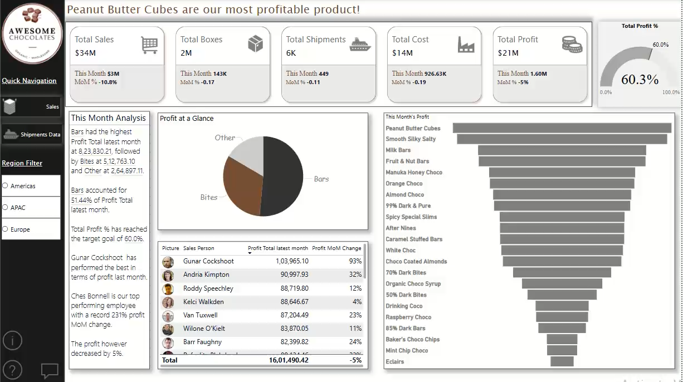
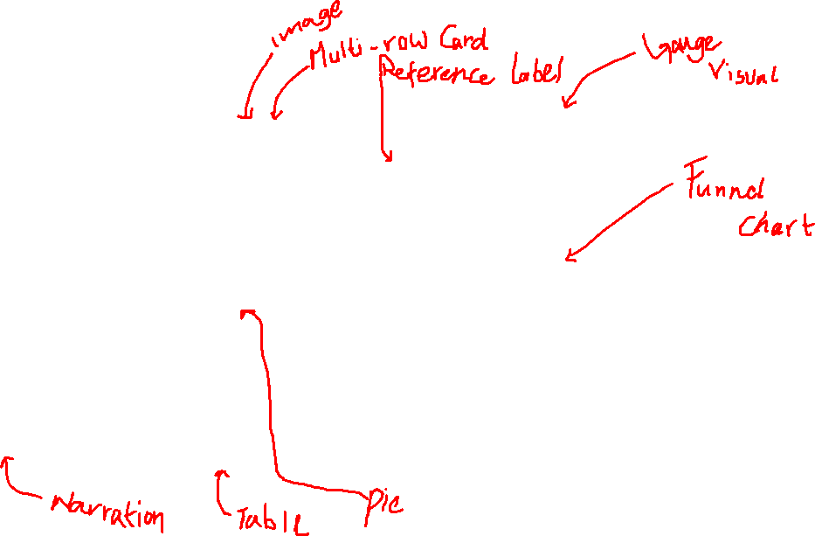
Profitability page

Slide 4
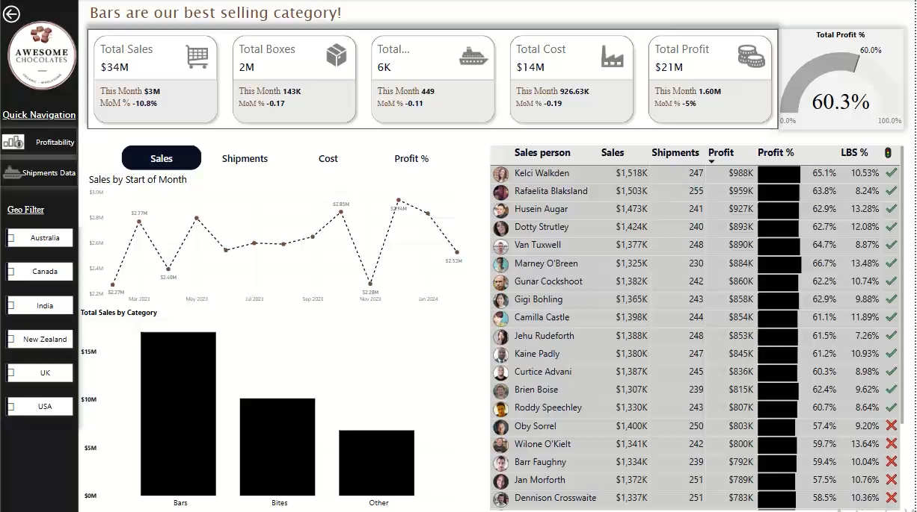
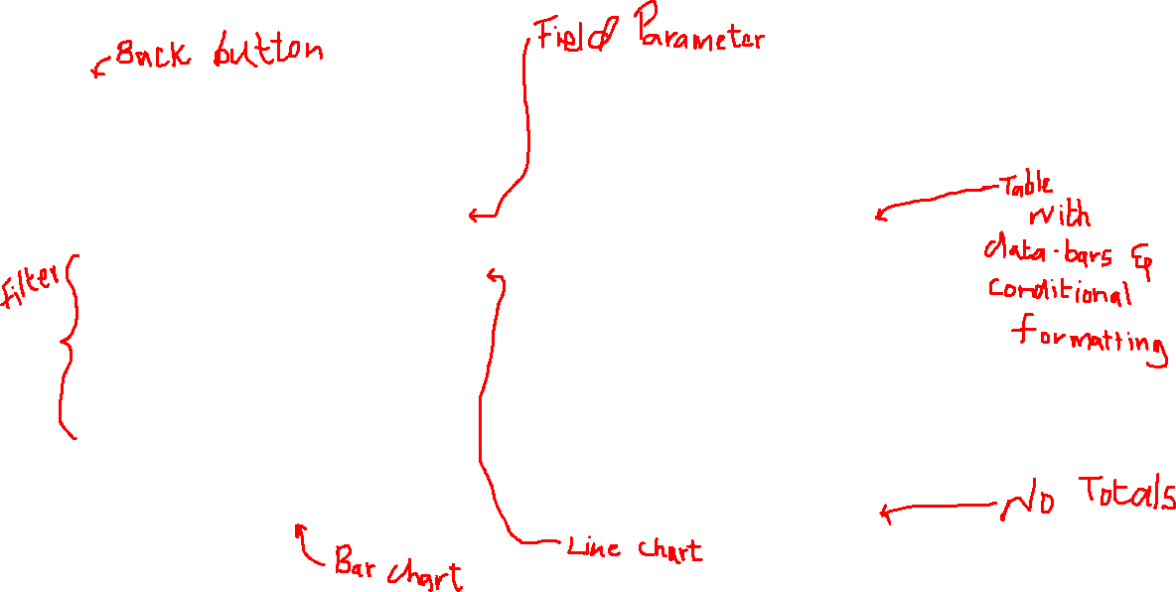
Sales Page

Slide 5
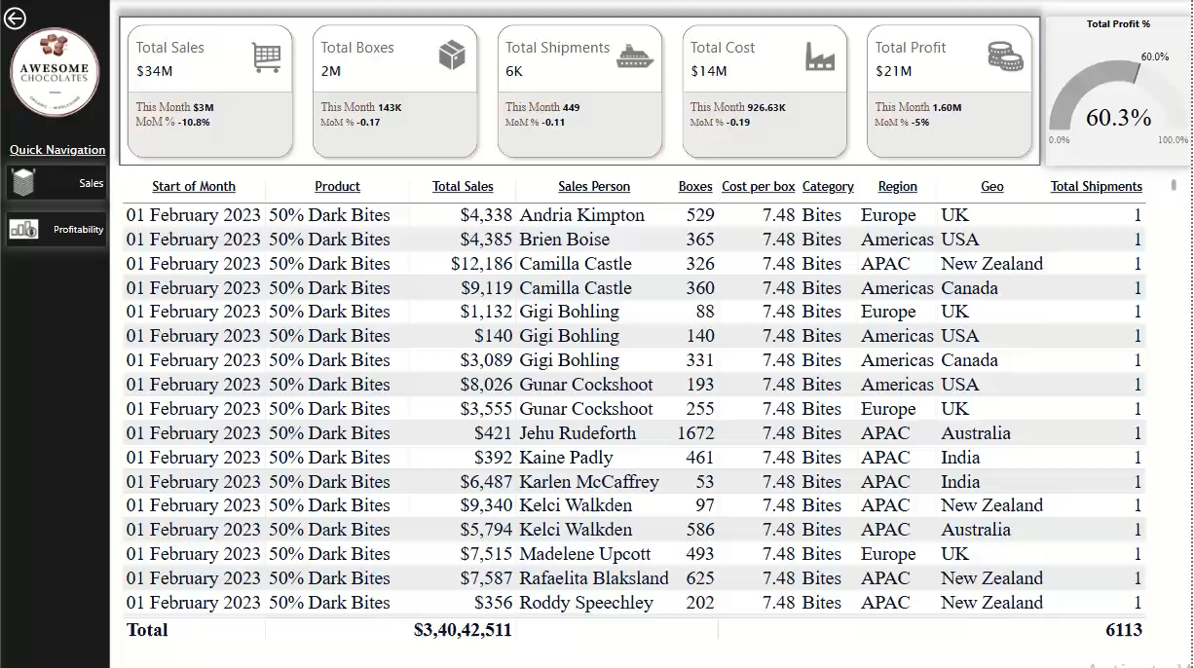
Shipments and info page

